Slide 1
Chapter 3 – Decomposition of Graphs
Parth Nagarkar
* Content borrowed from: S. Dasgupta, C. H. Papadimitriou, and U. V. Vazirani. Algorithms

Slide 2
Why graphs?
Many important problems can be represented as graphs
Social media data
Road network data
Graph searching algorithms are fundamental to the graph domain

Slide 3
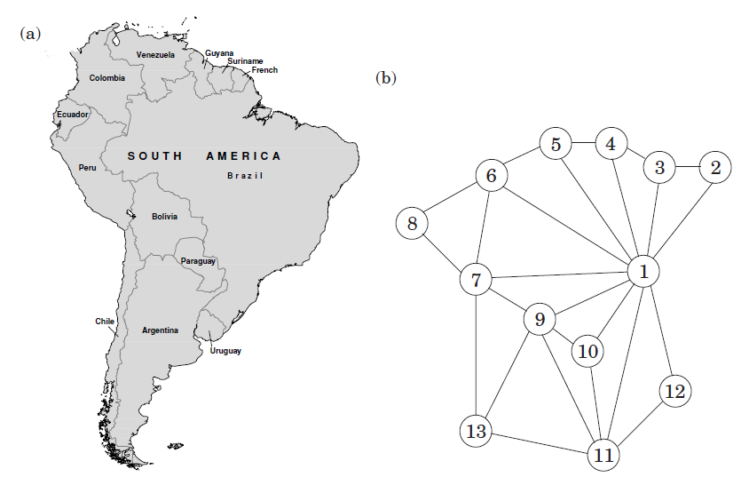
Example of Graph

Slide 4
Example of Graph

Slide 5
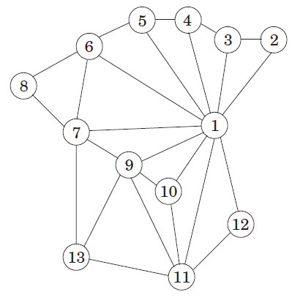
Formal Definition
Formally, a graph is specified by a set of vertices (also called nodes) V and by edges E between select pairs of vertices
V = {1, 2, 3, …, 13}
E includes {1, 2}, {9, 11} and so on

Slide 6
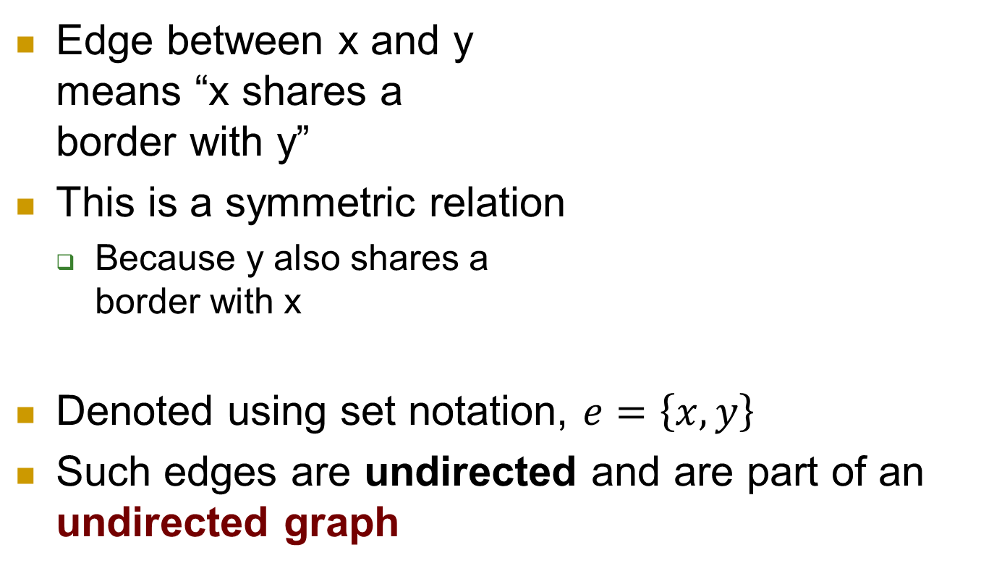
Undirected Graph
Edge between x and y means “x shares a border with y”
This is a symmetric relation
Because y also shares a border with x
Denoted using set notation, $e=\left\{x, y\right\}$
Such edges are undirected and are part of an undirected graph
Notes:
Example: Facebook friends

Slide 7
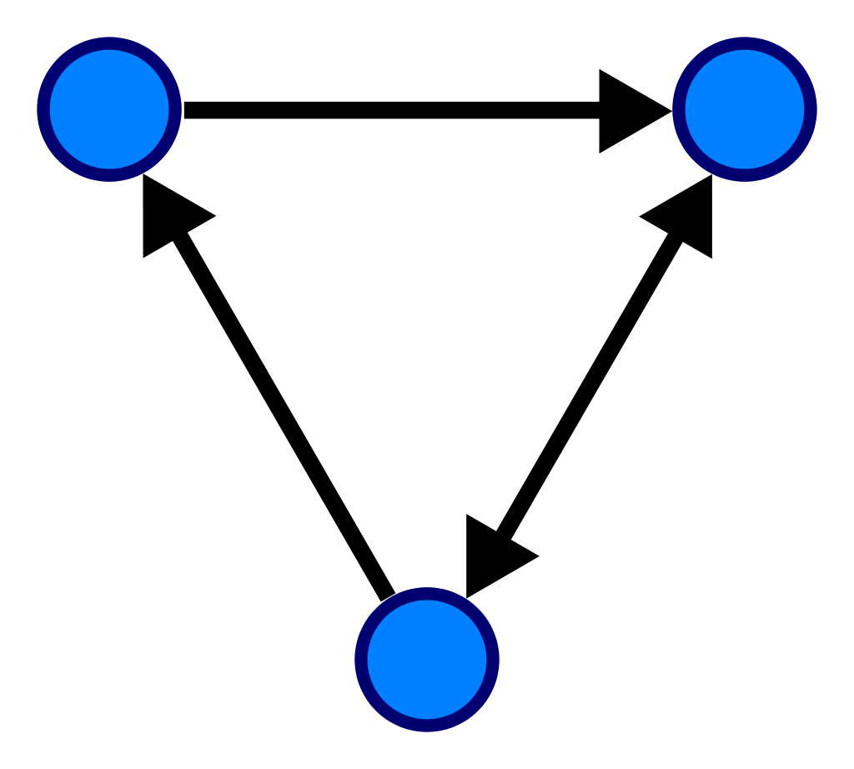
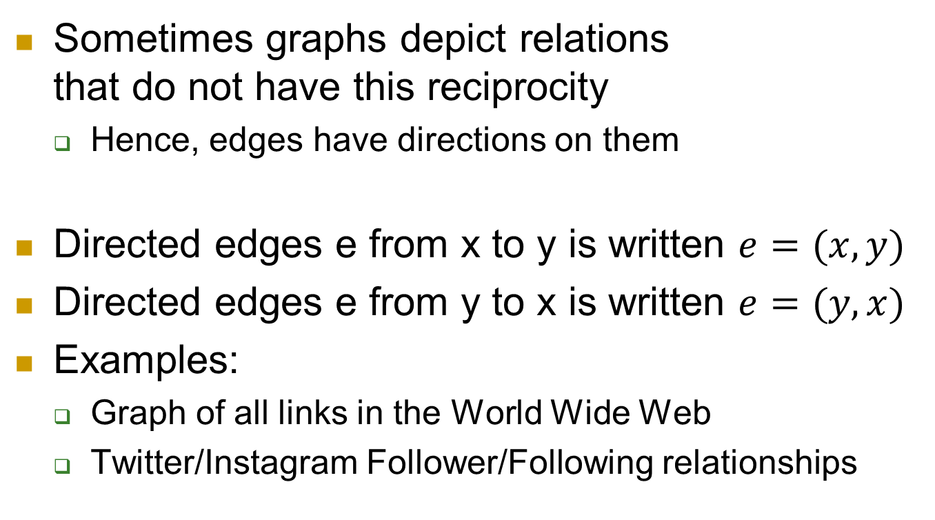
Directed Graph
Alice
Charlie
Sometimes graphs depict relations that do not have this reciprocity
Hence, edges have directions on them
Directed edges e from x to y is written $e=(x, y)$
Directed edges e from y to x is written $e=(y, x)$
Examples:
Graph of all links in the World Wide Web
Twitter/Instagram Follower/Following relationships
Bob

Slide 8

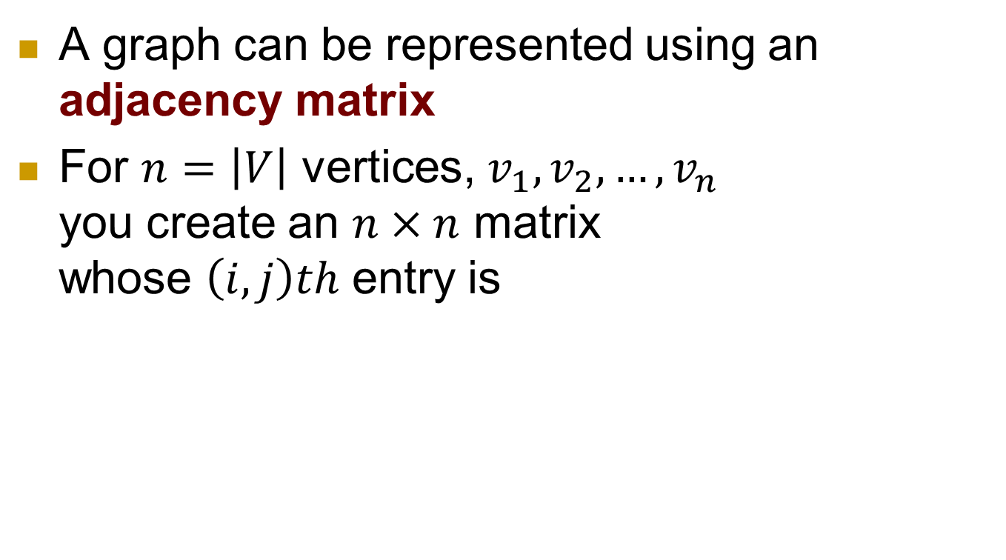
How is a graph represented?
A graph can be represented using an adjacency matrix
For $n=\left|V\right|$ vertices, $v_{1},v_{2},…,v_{n}$ you create an $n×n$ matrix whose $\left(i,j\right)th$ entry is

Slide 9
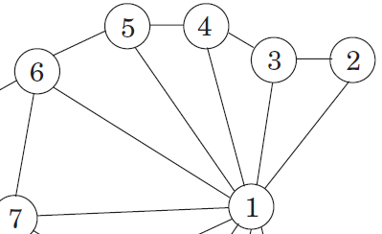
Adjacency matrix Example
Assume the South America graph has only the first 7 nodes (and its corresponding edges)
 | 1 | 2 | 3 | 4 | 5 | 6 | 7
1 | 1 | 1 | 1
2 | 1 | 1 | 1 | 0
3 | 1 | 1 | 1
4 | 1 | 0 | 1 | 1
5 | 1 | 0 | 0 | 1 | 1
6 | 1 | 0 | 0 | 0 | 1 | 1
7 | 1 | 0 | 0 | 0 | 0 | 1 | 1
** Numbers in bold maroon are node names
Notes:
Query: Is Brazil connected with Venezuela?

Slide 10
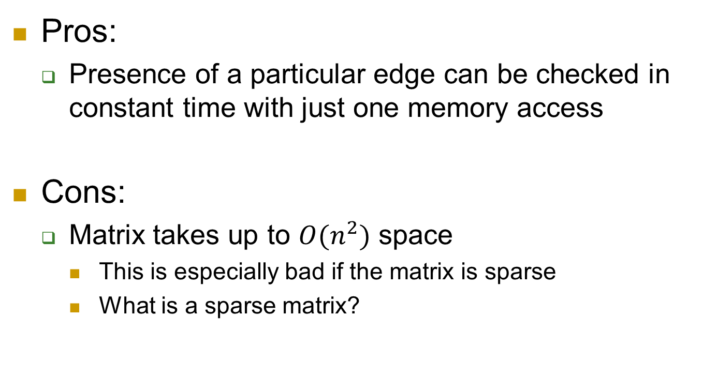
Adjacency Matrix
Pros:
Presence of a particular edge can be checked in constant time with just one memory access
Cons:
Matrix takes up to $O(n^{2})$ space
This is especially bad if the matrix is sparse
What is a sparse matrix?

Slide 11

Alternative representation: Adjacency Lists
Consists of $|V|$ lists, one per vertex
List for vertex $u$ holds the names of vertices to which $u$ has an outgoing edge
i.e. vertices $v$ for which $\left(u,v\right)∈E$
2
1
3
4
5
3
1

Slide 12
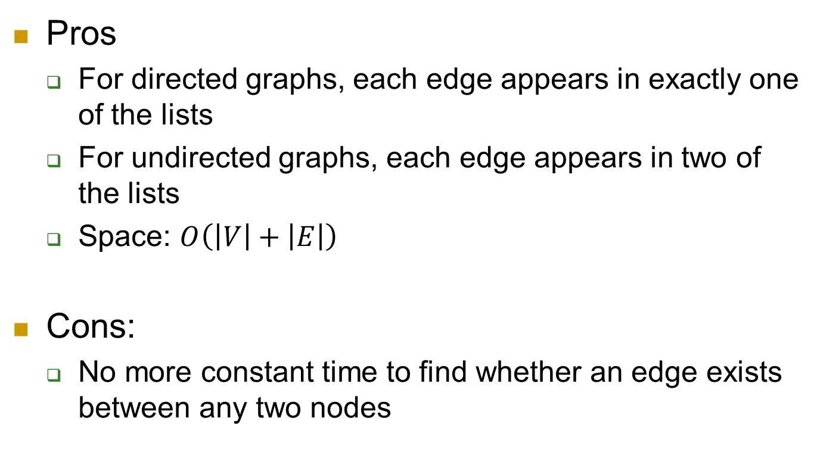
Adjacency Lists
Pros
For directed graphs, each edge appears in exactly one of the lists
For undirected graphs, each edge appears in two of the lists
Space: $O\left(\left|V\right|+\left|E\right|\right)$
Cons:
No more constant time to find whether an edge exists between any two nodes

Slide 13
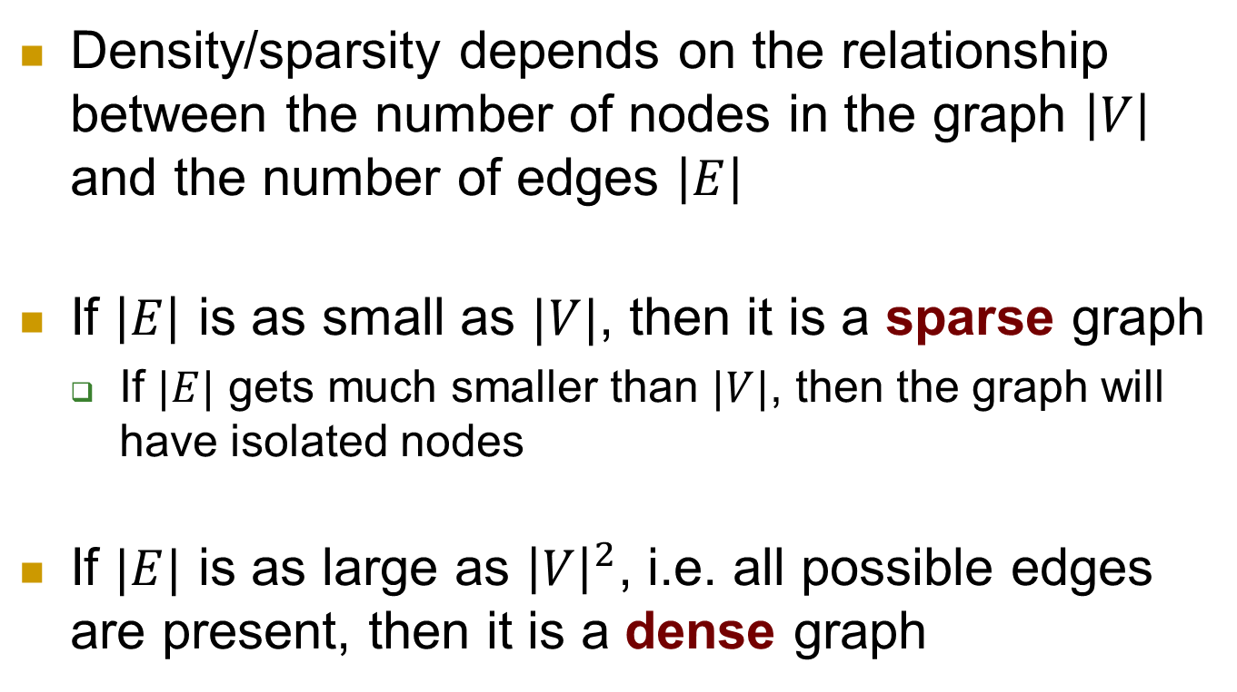
Dense vs sparse graph
Density/sparsity depends on the relationship between the number of nodes in the graph $\left|V\right|$ and the number of edges $\left|E\right|$
If $\left|E\right|$ is as small as $|V|$, then it is a sparse graph
If $|E|$ gets much smaller than $|V|$, then the graph will have isolated nodes
If $|E|$ is as large as ${\left|V\right|}^{2}$, i.e. all possible edges are present, then it is a dense graph
Notes:
As we shall see in this chapter and the next 2 chapters, exactly where |E| lies in this range is usually a crucial factor in selecting the right graph algorithm

Slide 14
How do you traverse a graph?
Answers the question:
What parts of the graph are reachable from a given vertex?
Adjacency list will let you do one basic operation: finding neighbors of a vertex
Depth-first search (DFS) and Breadth-first search (BFS)

Slide 15
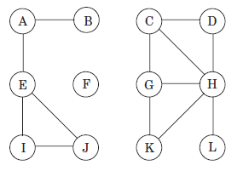
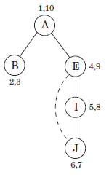
Depth-first Search
Start at some arbitrarily chosen node in the graph and explore as far as possible along each branch before backtracking
https://en.wikipedia.org/wiki/Depth-first_search

Slide 16
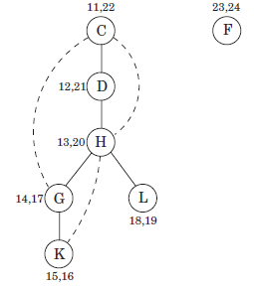
Depth-first Search
How many vertices does DFS traverse?
How many edges does DFS traverse?
https://en.wikipedia.org/wiki/Depth-first_search
Notes:
Each resultant tree is called a DFS spanning tree. The collection of these trees is called a forest.
How many vertices does DFS traverse? O(|V|)
How many edges does DFS traverse? Each edge traversed exactly twice.

Slide 17
Depth-first Search
Implemented using a stack
Last-In-First-Out (LIFO)
Notes:
Push and pop operations of a stack

Slide 18
Depth-first Search
Implemented using a stack
Last-In-First-Out (LIFO)
Previsit, Postvisit
Previsit = moment of first discovery
Postvisit = moment of final departure
Notes:
Push and pop operations of a stack

Slide 19
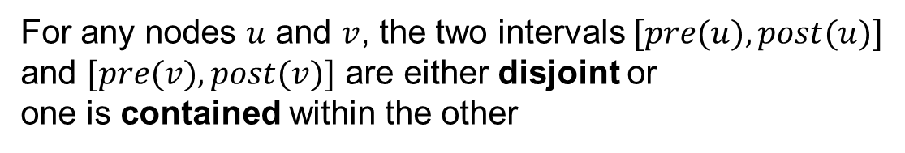
Depth-first Search
Implemented using a stack
Last-In-First-Out (LIFO)
Previsit, Postvisit
Previsit = moment of first discovery
Postvisit = moment of final departure
For any nodes $u$ and $v$, the two intervals $[pre(u), post(u)]$ and $[pre(v), post(v)]$ are either disjoint or
one is contained within the other
Notes:
This is a famous property. [pre(u), post(u)] is essentially the time during which vertex u was on the stack.

Slide 20
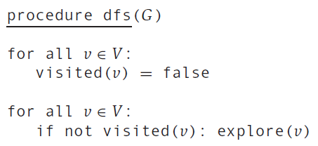
Depth-first Search
The running time is dependent on the chosen vertex
Let’s consider all vertices together

Slide 21
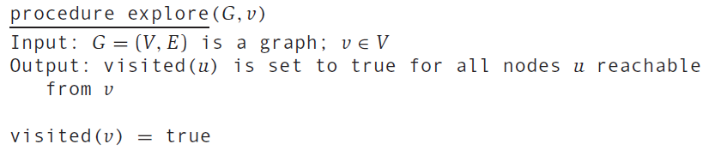

Depth-first Search
The running time is dependent on the chosen vertex
Let’s consider all vertices together

Slide 22
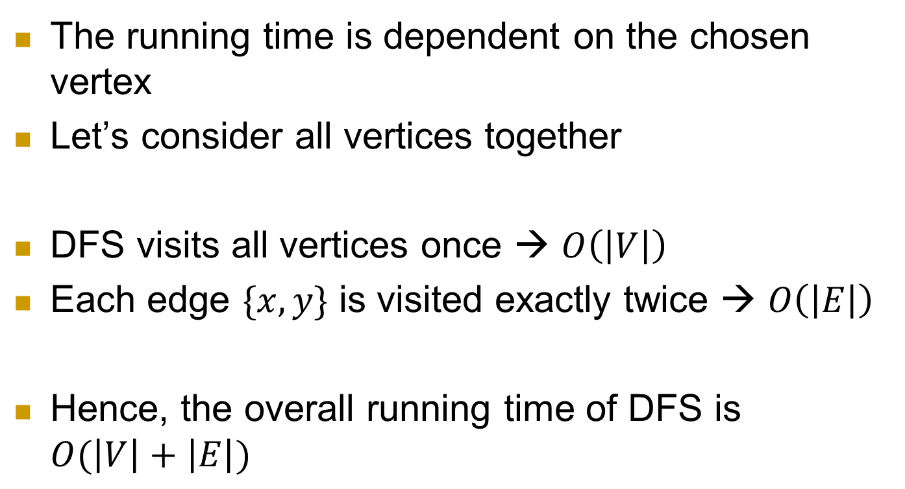
Depth-first Search
The running time is dependent on the chosen vertex
Let’s consider all vertices together
DFS visits all vertices once → $O\left(\left|V\right|\right)$
Each edge $\{x, y\}$ is visited exactly twice → $O\left(\left|E\right|\right)$
Hence, the overall running time of DFS is $O(\left|V\right|+\left|E\right|)$

Slide 23
Connectivity in undirected graphs
An undirected graph is connected if there is a path between any pair of vertices
This graph is not connected because, e.g., there is no path from A to K
But it has three disjoint connected regions: {A, B, E, I, J}, {C, D, G, H, K, L}, {F}
These regions are called connected components

Slide 24
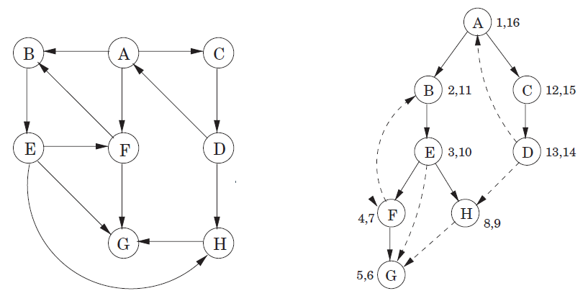
DFS in Directed Graphs
DFS should traverse edges only in their prescribed directions

Slide 25
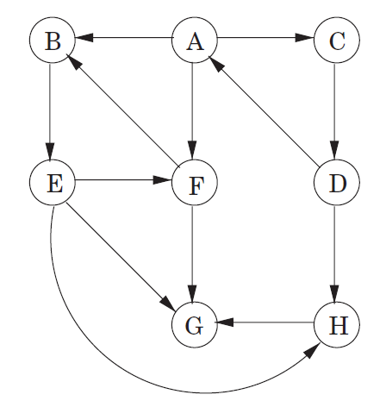
How would DFS work for this graph (using a stack)?

Slide 26
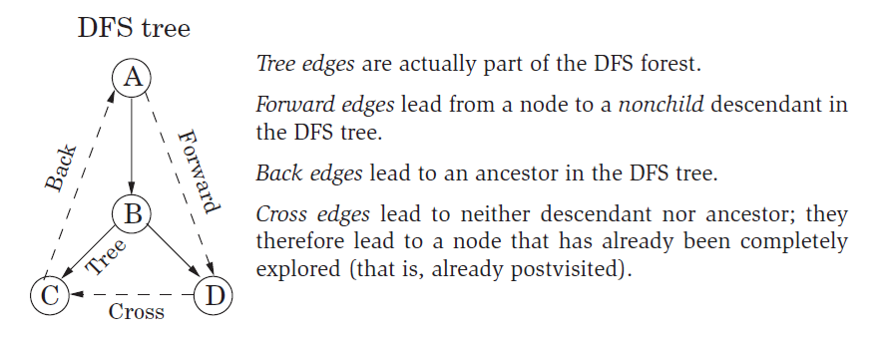
Types of Edges

Slide 27
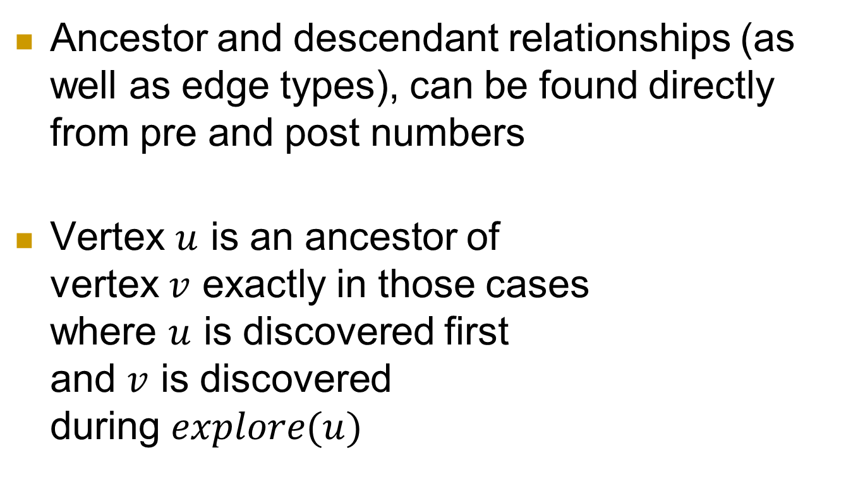
Types of Edges
Ancestor and descendant relationships (as well as edge types), can be found directly from pre and post numbers
Vertex $u$ is an ancestor of vertex $v$ exactly in those cases where $u$ is discovered first and $v$ is discovered during $explore(u)$

Slide 28
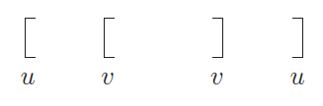
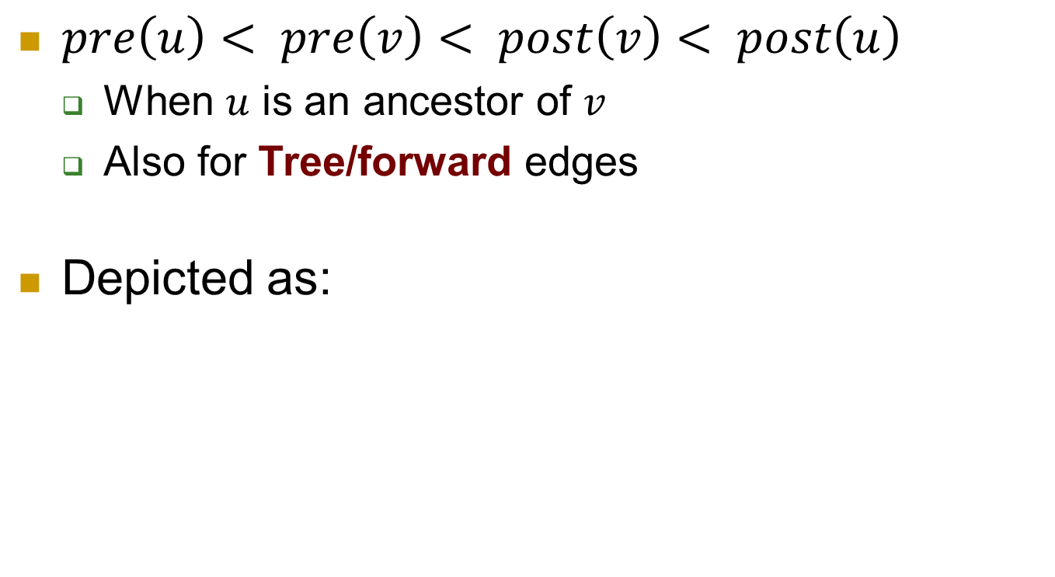
Types of Edges
$pre\left(u\right)< pre\left(v\right)< post\left(v\right)< post\left(u\right)$
When $u$ is an ancestor of $v$
Also for Tree/forward edges
Depicted as:

Slide 29

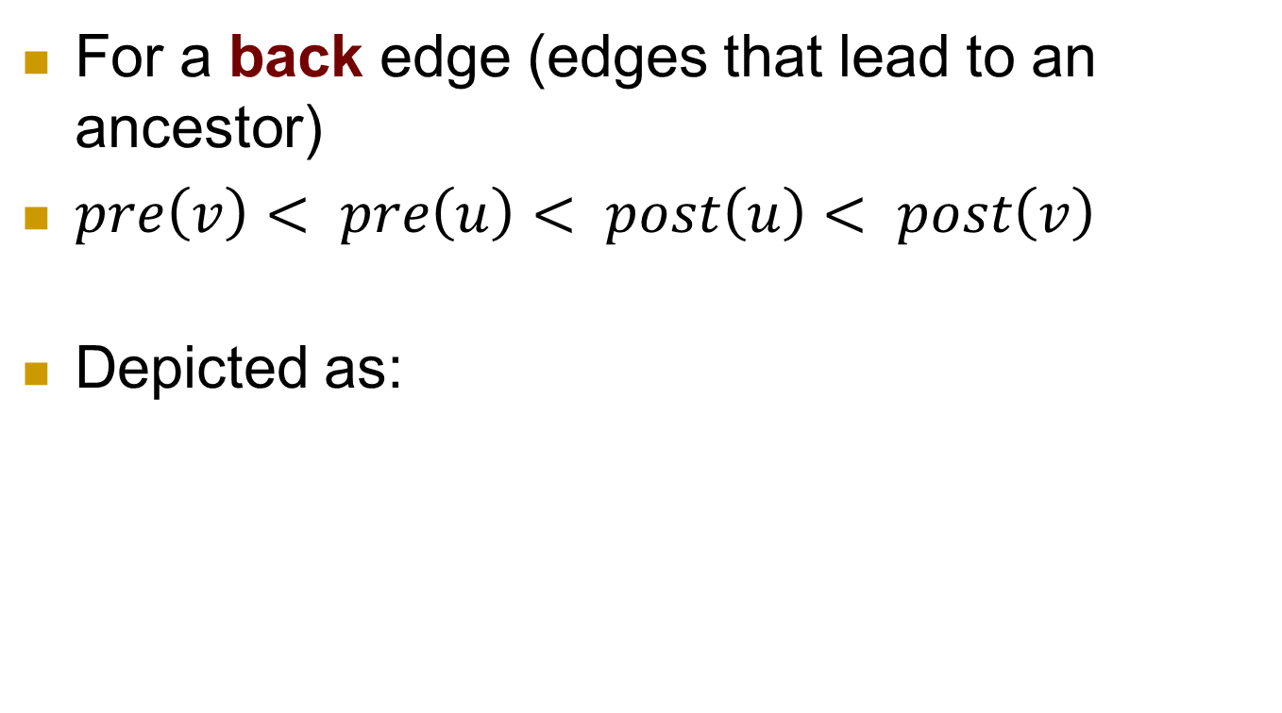
Types of Edges
For a back edge (edges that lead to an ancestor)
$pre\left(v\right)< pre\left(u\right)< post\left(u\right)< post\left(v\right)$
Depicted as:

Slide 30
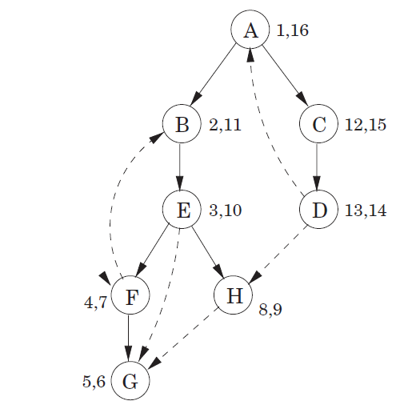

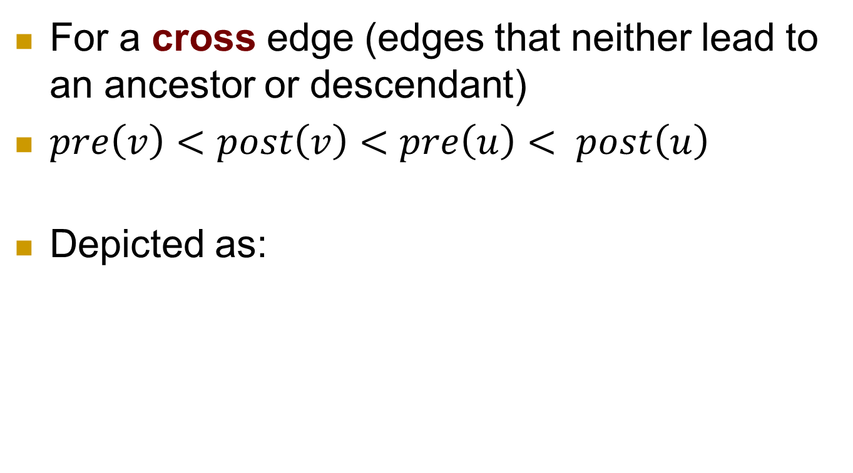
Types of Edges
For a cross edge (edges that neither lead to an ancestor or descendant)
$pre\left(v\right)<post\left(v\right)<pre\left(u\right)< post\left(u\right)$
Depicted as:

Slide 31
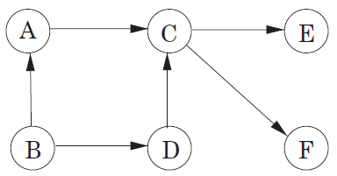

Directed Acyclic Graphs (DAGs)
A cycle in a directed graph is a circular path $v_{0} →v_{1}→v_{2}→ …→v_{k}→v_{0}$
A graph without cycles is acyclic
Notes:
DAGs can model many different kinds of information. For example, a spreadsheet can be modeled as a DAG, with a vertex for each cell and an edge whenever the formula in one cell uses the value from another (https://en.wikipedia.org/wiki/Directed_acyclic_graph)

Slide 32
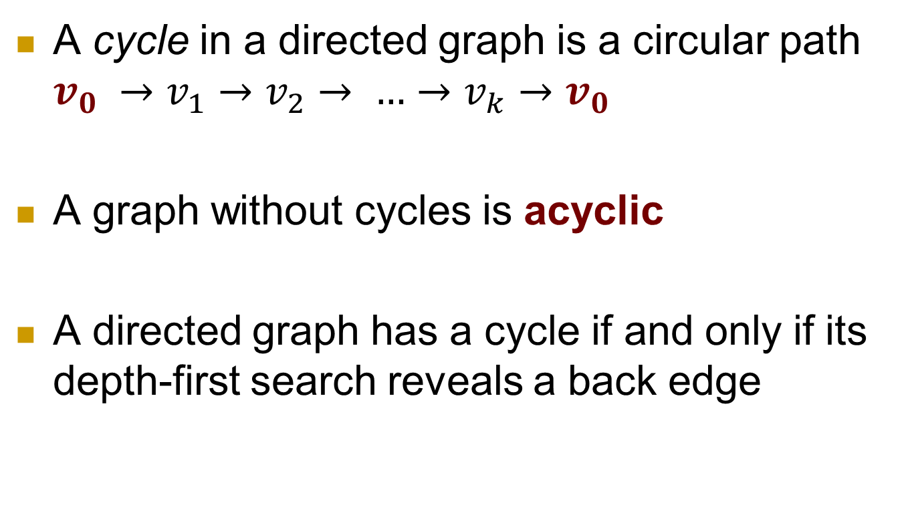
Directed Acyclic Graphs (DAGs)
A cycle in a directed graph is a circular path $v_{0} →v_{1}→v_{2}→ …→v_{k}→v_{0}$
A graph without cycles is acyclic
A directed graph has a cycle if and only if its depth-first search reveals a back edge
Notes:
DAGs can model many different kinds of information. For example, a spreadsheet can be modeled as a DAG, with a vertex for each cell and an edge whenever the formula in one cell uses the value from another (https://en.wikipedia.org/wiki/Directed_acyclic_graph)

Slide 33

Directed Acyclic Graphs (DAGs)
Constraints, like $C$ should be completed after $A$, can be conveniently represented using a directed graph
Notes:
DAGs can model many different kinds of information. For example, a spreadsheet can be modeled as a DAG, with a vertex for each cell and an edge whenever the formula in one cell uses the value from another (https://en.wikipedia.org/wiki/Directed_acyclic_graph)

Slide 34
Directed Acyclic Graphs (DAGs)
All DAGs can be linearized (topologically sorted)
Order the vertices one after the other in such a way that each edge goes from an earlier vertex to a later vertex
All precedence constraints must be satisfied

Slide 35
Directed Acyclic Graphs (DAGs)
One valid ordering: B, A, D, C, E, F
There are three other valid orderings
How do you do it?

Slide 36
Directed Acyclic Graphs (DAGs)
Let’s first draw the DFS tree for this DAG

Slide 37
Directed Acyclic Graphs (DAGs)
B
1,12
A
2,9
D
10,11
C
3,8
4,5
6,7
F
E

Slide 38

Directed Acyclic Graphs (DAGs)
In order to find a valid ordering, you have to perform the tasks in decreasing order of their $post$ numbers
B
1,12
A
2,9
D
10,11
C
3,8
4,5
6,7
F
E
B, D, A, C, E, F

Slide 39

Directed Acyclic Graphs (DAGs)
Vertex with the smallest $post$ number comes last in this linearization
And hence it must be a $sink$
$Sink$ = no outgoing edges
B
1,12
A
2,9
D
10,11
C
3,8
4,5
6,7
F
E
B, D, A, C, E, F

Slide 40

Directed Acyclic Graphs (DAGs)
Vertex with the highest $post$ number is called a $source$
$Source$ = no incoming edges
B
1,12
A
2,9
D
10,11
C
3,8
4,5
6,7
F
E
B, D, A, C, E, F

Slide 41

Directed Acyclic Graphs (DAGs)
Property: In a DAG, there has to be at least one $source$ and at least one $sink$
B
1,12
A
2,9
D
10,11
C
3,8
4,5
6,7
F
E
Notes:
This is because the only edges (u, v) in a graph for which post (u) < post (v) are back edges, which are not allowed in a DAG

Slide 42

Directed Acyclic Graphs (DAGs)
Property: In a DAG, every edge leads to a vertex with a lower $post$ number
B
1,12
A
2,9
D
10,11
C
3,8
4,5
6,7
F
E
Notes:
This is because the only edges (u, v) in a graph for which post (u) < post (v) are back edges, which are not allowed in a DAG

Slide 43
Directed Acyclic Graphs (DAGs)
What is the complexity for finding a linear order in a DAG?
We need to do DFS, which is a linear time algorithm
B
1,12
A
2,9
D
10,11
C
3,8
4,5
6,7
F
E
Notes:
This is because the only edges (u, v) in a graph for which post (u) < post (v) are back edges, which are not allowed in a DAG

Slide 44
Connectivity in Directed Graphs
In undirected graphs, a graph is connected if there is a path between any pair of vertices
So what about this graph? Is this graph connected using the above definition?

Slide 45

Connectivity in Directed Graphs
Two nodes $u$ and $v$ of a directed graph are connected if there is a path from $u$ to $v$ and a path from $v$ to $u$

Slide 46
Connectivity in Directed Graphs
A graph is said to be strongly connected if every vertex is reachable from every other vertex
Is this graph strongly connected?
No
No path from A to B
Notes:
https://en.wikipedia.org/wiki/Strongly_connected_component

Slide 47
Connectivity in Directed Graphs
A graph is said to be strongly connected if every vertex is reachable from every other vertex
Strongly connected components of a directed graph form a partition into subgraphs that are themselves strongly connected
Notes:
https://en.wikipedia.org/wiki/Strongly_connected_component

Slide 48
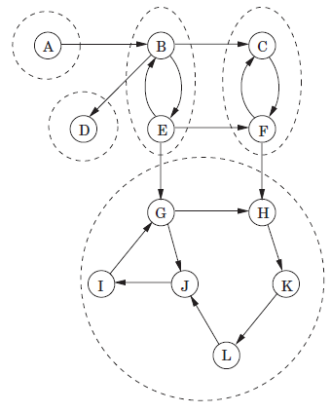
Connectivity in Directed Graphs
Strongly connected components of a directed graph form a partition into subgraphs that are themselves strongly connected
5 strongly connected components in this graph
Notes:
https://en.wikipedia.org/wiki/Strongly_connected_component

Slide 49
Connectivity in Directed Graphs
How many strongly connected components are there in this graph?
6
Notes:
https://en.wikipedia.org/wiki/Strongly_connected_component

Slide 50
Applications of Strongly Connected Components (SCC)
SCC can help you find groups of people in a graph that are more closely related than the rest of the data
Useful for advertisements on social media
Solving 2-satisfiability problems
Computing Dulmage-Mendelsohn decomposition
Notes:
https://en.wikipedia.org/wiki/Strongly_connected_component

Slide 51
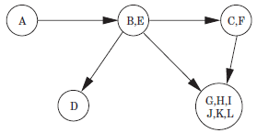
Connectivity in Directed Graphs
If each strongly connected component
is shrank to a single meta-node, the resulting meta-graph must be a dag.
Notes:
The reason is that a cycle containing several strongly connected components would merge them all into a single, strongly connected component

Slide 52
Connectivity in Directed Graphs
Every directed graph is a dag of its strongly connected components.

Slide 53
Connectivity in Directed Graphs
Connectivity structure of a directed graph is two-tiered
Notes:
At the top-level is a dag which can be linearized. If we want finer detail, we can look inside one of the nodes of this dag and examine the strongly connected component within.

Slide 54
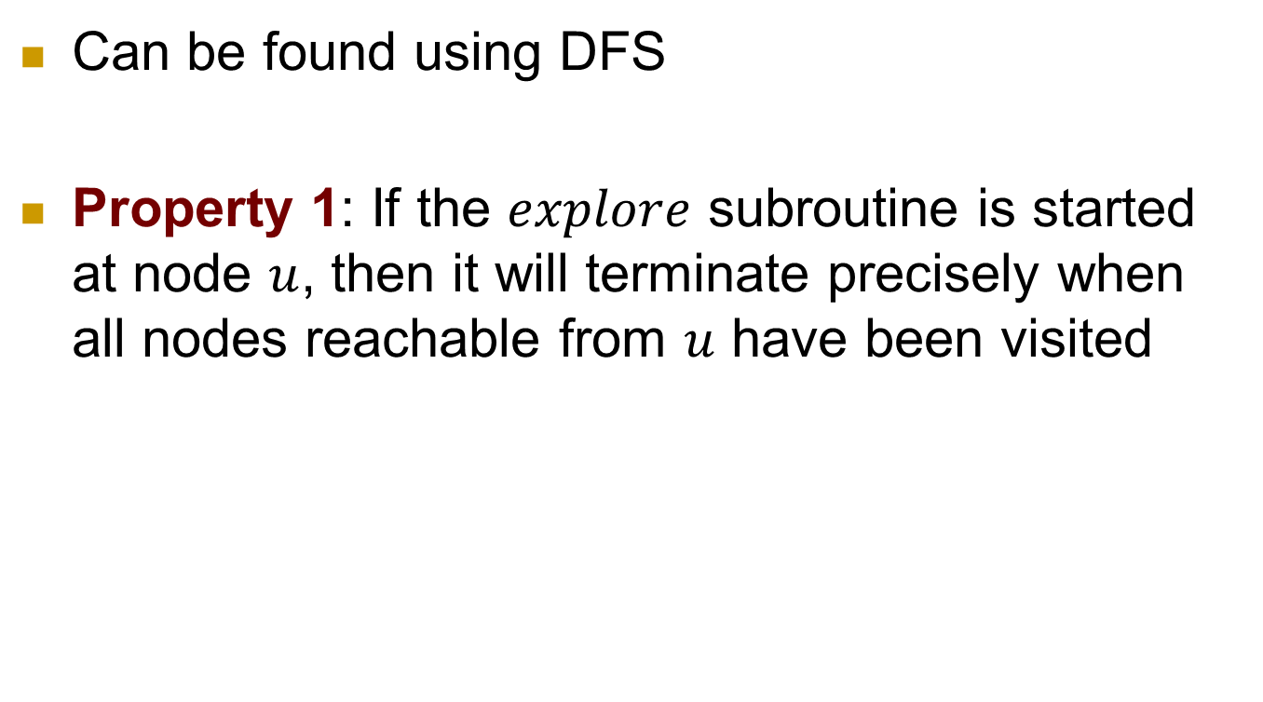
How to find Strongly Connected Components?
Can be found using DFS
Property 1: If the $explore$ subroutine is started at node $u$, then it will terminate precisely when all nodes reachable from $u$ have been visited

Slide 55
Connectivity in Directed Graphs
Sink Strongly Connected Component: An SCC that is a sink in the meta-graph
Notes:
Sink = no outgoing edge
Source = no incoming edge
D and G/H/I/J/K/L are two sink SCC
Opposite definition for Source Strongly Connected Components

Slide 56

How to find Strongly Connected Components (SCC)?
if $explore$ is called on a sink SCC, then we will retrieve exactly that whole SCC

Slide 57
How to find Strongly Connected Components (SCC)?
2 problems:
1) How do we find a node that we know for sure lies in a sink SCC?
2) How do we continue once the first component has been discovered?

Slide 58
How to find Strongly Connected Components (SCC)?
Problem 1:
There is not an easy direct way to pick out a node that is guaranteed to lie in a sink SCC
But there is a way to get a node in a source SCC
Notes:
Source SCC: An SCC that is a source in the meta-graph
Source = no incoming edge

Slide 59
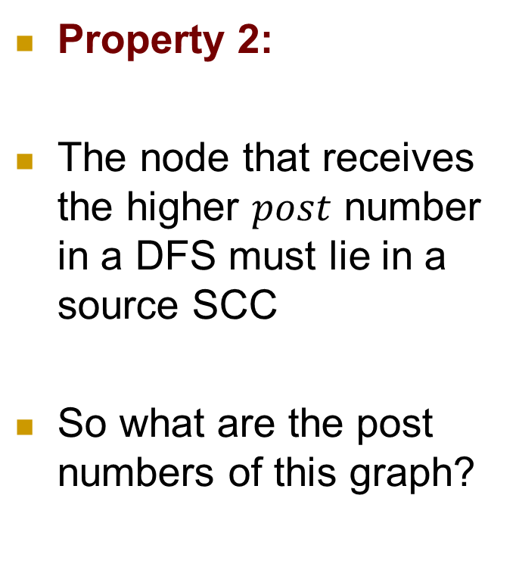
How to find Strongly Connected Components (SCC)?
Property 2:
The node that receives the higher $post$ number in a DFS must lie in a source SCC
So what are the post numbers of this graph?
Notes:
Source SCC: An SCC that is a source in the meta-graph
Source = no incoming edge

Slide 60
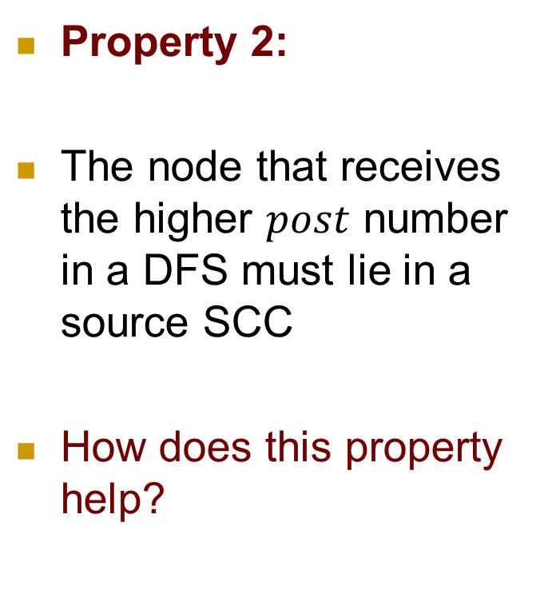
How to find Strongly Connected Components (SCC)?
Property 2:
The node that receives the higher $post$ number in a DFS must lie in a source SCC
How does this property help?
Notes:
Source SCC: An SCC that is a source in the meta-graph
Source = no incoming edge

Slide 61
How to find Strongly Connected Components (SCC)?
Draw a DFS tree of this graph starting from A
Notes:
Source SCC: An SCC that is a source in the meta-graph
Source = no incoming edge

Slide 62
How to find Strongly Connected Components (SCC)?
Property 2 helps us find a node in the source SCC of G
We want to find a node in the sink component
Notes:
Exactly opposite of what we need

Slide 63
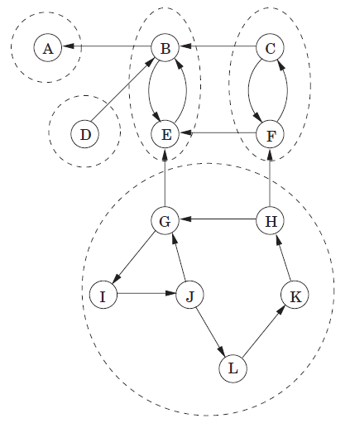


How to find Strongly Connected Components (SCC)?
Create a reverse graph $G^{R}$
$G^{R}$ has exactly the same SCC as G
Notes:
Same as the graph on the left but the edges are reversed

Slide 64
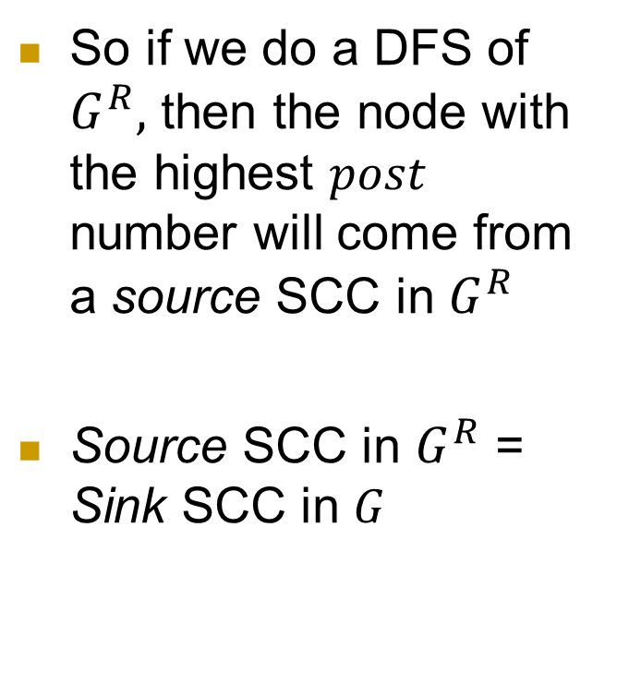
How to find Strongly Connected Components (SCC)?
Create a reverse graph $G^{R}$
So if we do a DFS of $G^{R},$ then the node with the highest $post$ number will come from a source SCC in $G^{R}$
Source SCC in $G^{R}$ = Sink SCC in $G$
Notes:
Same as the graph on the left but the edges are reversed

Slide 65
How to find Strongly Connected Components (SCC)?
2 problems:
1) How do we find a node that we know for sure lies in a sink SCC?
2) How do we continue once the first component has been discovered?

Slide 66
How to find Strongly Connected Components (SCC)?
2 problems:
1) How do we find a node that we know for sure lies in a sink SCC?
2) How do we continue once the first component has been discovered?
Solved!

Slide 67
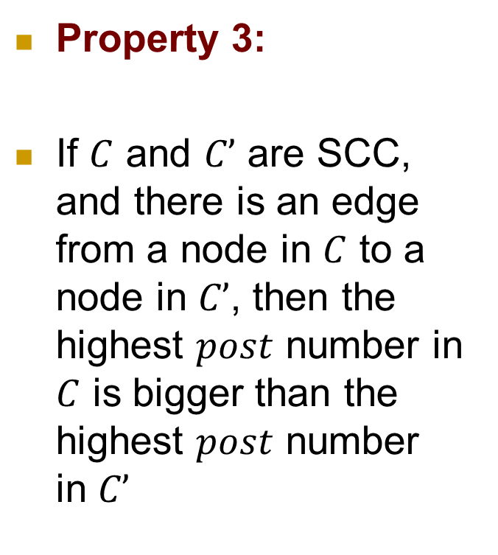
How to find Strongly Connected Components (SCC)?
Property 3:
If $C$ and $C’$ are SCC, and there is an edge from a node in $C$ to a node in $C’$, then the highest $post$ number in $C$ is bigger than the highest $post$ number in $C’$
Notes:
Source SCC: An SCC that is a source in the meta-graph
Source = no incoming edge

Slide 68
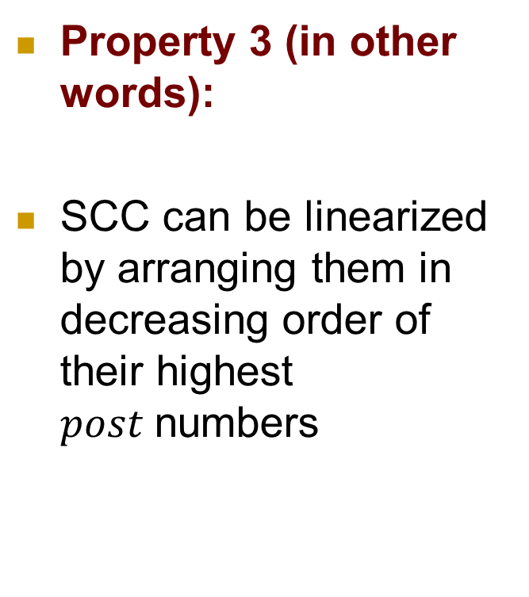
How to find Strongly Connected Components (SCC)?
Property 3 (in other words):
SCC can be linearized by arranging them in decreasing order of their highest $post$numbers
Notes:
Source SCC: An SCC that is a source in the meta-graph
Source = no incoming edge

Slide 69
How to find Strongly Connected Components (SCC)?
Once we have found the first SCC and deleted it from the graph, the node with the highest post number among the remaining will belong to a sink SCC of the remaining G
Notes:
Source SCC: An SCC that is a source in the meta-graph
Source = no incoming edge

Slide 70
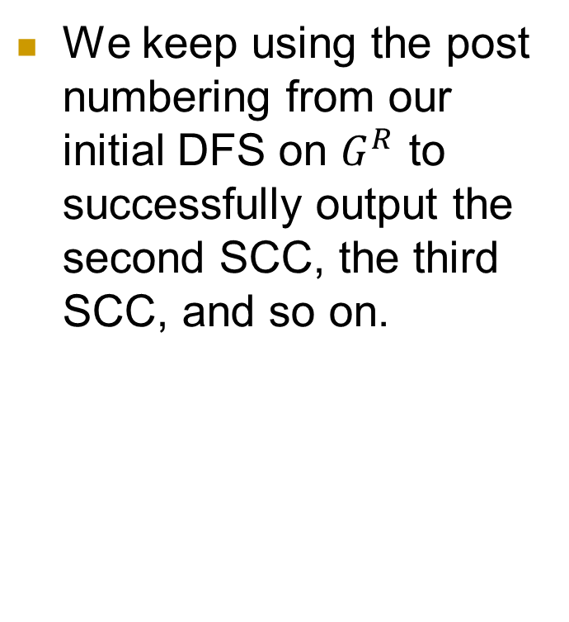
How to find Strongly Connected Components (SCC)?
We keep using the post numbering from our initial DFS on $G^{R}$ to successfully output the second SCC, the third SCC, and so on.
Notes:
Source SCC: An SCC that is a source in the meta-graph
Source = no incoming edge

Slide 71
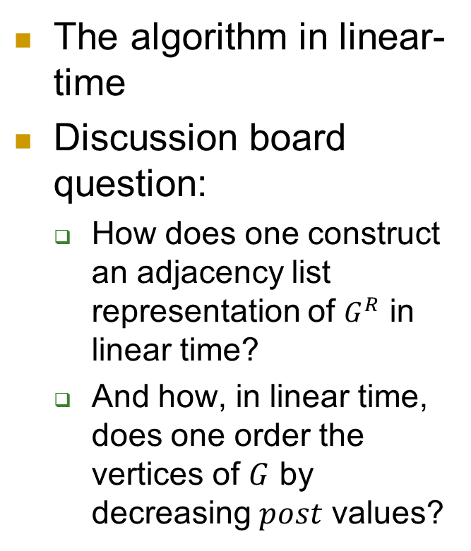
How to find Strongly Connected Components (SCC)?
The algorithm in linear-time
Discussion board question:
How does one construct an adjacency list representation of $G^{R}$ in linear time?
And how, in linear time, does one order the vertices of $G$ by decreasing $post$ values?
Notes:
Source SCC: An SCC that is a source in the meta-graph
Source = no incoming edge

Slide 72
How to find Strongly Connected Components (SCC)?
Run the algorithm on this graph as an exercise
Notes:
Source SCC: An SCC that is a source in the meta-graph
Source = no incoming edge

